Slide 1

Preparing to Collect Data Online
Janet Salmons, PhD

Slide 2
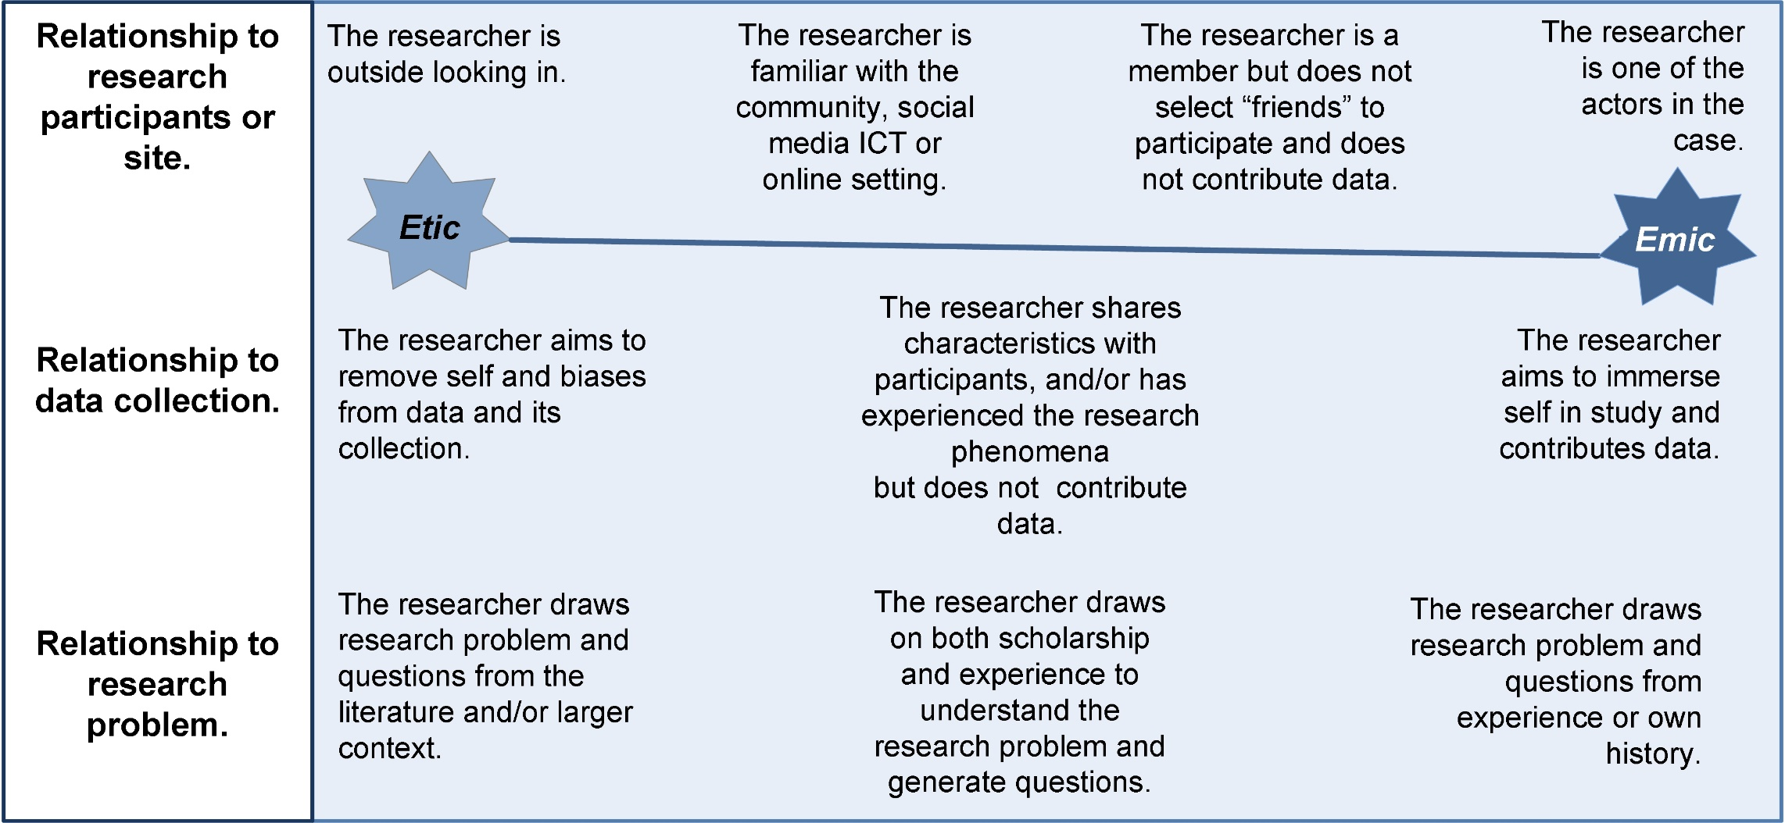
roles, positions and relationship to the study
How can you explain your position in relation to the study?

